Slide 1
MEMORY MANAGEMENT: MANAGEMENT OF PHYSICAL MEMORY
- VIRESH
CSE
4AL18CS097

Slide 2
Memory Management:
Memory management under Linux has two components.
The first deals with allocating and freeing physical memory-pages, groups of pages, and small blocks of memory.
The second handles virtual memory, which is memory mapped into the address space of running processes.

Slide 3
Management of Physical Memory:
Due to specific hardware characteristics, Linux separates physical memory into three different zones or regions:
ZONE_DMA
ZONE_NORMAL
ZONE_HIGHMEM
These zones are architecture specific. For example, on the Intel 80x86 architecture, certain ISA (industry standard architecture) devices can only access the lower 16 MB of physical memory using DMA.

Slide 4
On these systems, the first 16 MB of physical memory comprise ZONE_DMA.
ZONE_NORMAL identifies physical memory that is mapped to the CPU's address space. This zone is used for most routine memory requests.
For architectures that do not limit what DMA can access, ZONE_DMA is not present, and ZONE_NORMAL is used.
Finally, ZONE_HIGHMEM (for "high memory") refers to physical memory that is not mapped into the kernel address space.
For example, on the 32-bit Intel architecture (where 232 provides a 4-GB address space), the kernel is mapped into the first 896 MB of the address space; the remaining memory is referred to as high memory and is allocated from ZONE_HIGHMEM.

Slide 5
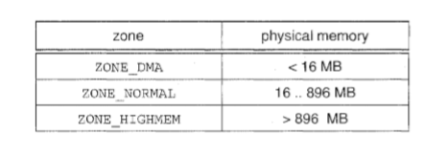
The relationship of zones and physical addresses on the Intel 80x86 architecture:
The kernel maintains a list of free pages for each zone. When a request for physical memory arrives, the kernel satisfies the request using the appropriate zone.
The primary physical-memory manager in the Linux kernel is the page allocator.
Each zone has its own allocator, which is responsible for allocating and freeing all physical pages for the zone and is capable of allocating ranges of physically contiguous pages on request.

Slide 6
Slab allocator in Linux:
Another strategy adopted by Linux for allocating kernel memory is known as slab allocation.
A slab is used for allocating memory for kernel data structures and is made up of one or more physically contiguous pages.
A cache consists of one or more slabs.
There is a single cache for each unique kernel data structure -a cache for the data structure representing process descriptors, a cache for file objects, a cache for semaphores, and so forth.

Slide 7
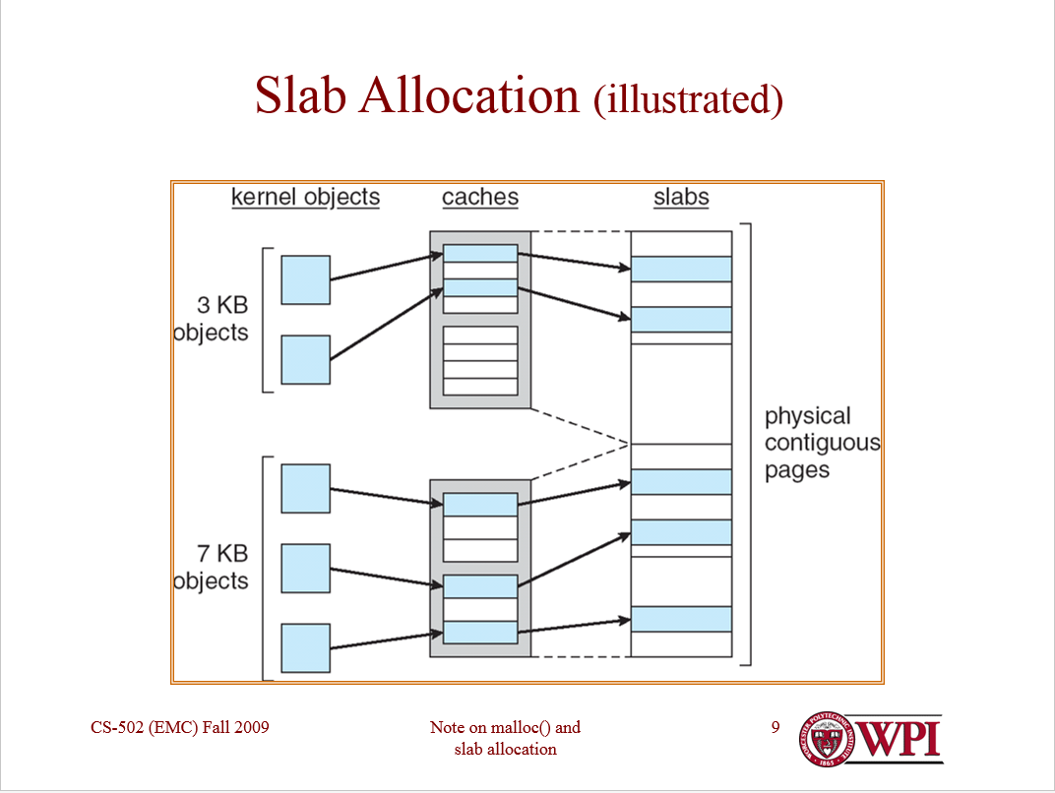
The relationship among slabs, caches, and objects:
The figure shows two kernel objects 3 KB in size and three objects 7 KB in size.
These objects are stored in the respective caches for 3-KB and 7-KB objects.
The slab-allocation algorithm uses caches to store kernel objects.

Slide 8
When a cache is created, a number of objects are allocated to the cache.
The number of objects in the cache depends on the size of the associated slab. For example, a 12-KB slab (made up of three contiguous 4-KB pages) could store six 2-KB objects.
Initially, all the objects in the cache are marked as free.
When a new object for a kernel data structure is needed, the allocator can assign any free object from the cache to satisfy the request.
The object assigned from the cache is marked as used.

Slide 9
In Linux, a slab may be in one of three possible states:
Full. All objects in the slab are marked as used.
Empty. All objects in the slab are marked as free.
Partial. The slab consists of both used and free objects.
The slab allocator first attempts to satisfy the request with a free object in a partial slab.
If none exist, a free object is assigned from an empty slab.
If no empty slabs are available, a new slab is allocated from contiguous physical pages and assigned to a cache.

Slide 10
THANK YOU

